Slide 1

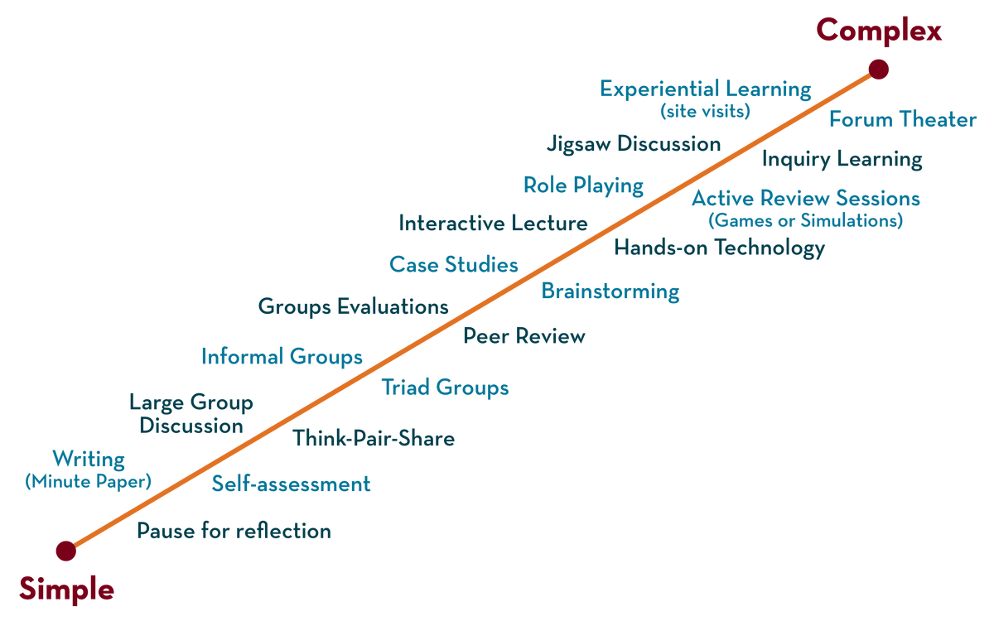
Department of CSE Honors
COURSE NAME: CLOUD SERVERLESS COMPUTING
COURSE CODE: 20CS3281AA/PA
Topic:
ViDEO TRANSCODER
FACULTYNAME:V.NARESH SIR
ID:2000030535
NAME:KURREANUHYA

Slide 2



AIM OF THE SESSION
To familiarize students with the basic concept of
INSTRUCTIONAL OBJECTIVES
This Session is designed to:
Demonstrate
Describe
List out the
Describe the
LEARNING OUTCOMES
At the end of this session, you should be able to:
Define
Describe
Summarize

Slide 3
SESSION INTRODUCTION
AMAZON ELASTIC TRANSCODER: Amazon Elastic Transcoder is media transcoding in the cloud. It is designed to be a highly scalable, easy to use and a cost effective way for developers and businesses to convert (or “transcode”) media files from their source format into versions that will playback on devices like smartphones, tablets and PCs.

Slide 4
SESSION DESCRIPTION
STEPS TO CONDUCT THIS ACTIVITY

Slide 5
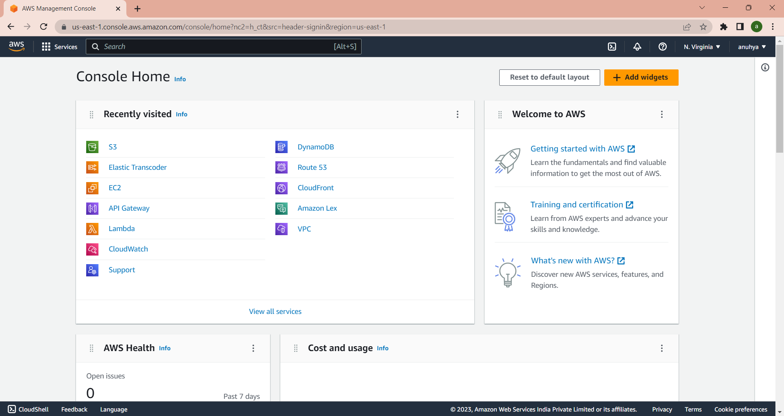
SESSION DESCRIPTION (Cont..)
STEP 1: Sign into the AWS console

Slide 6
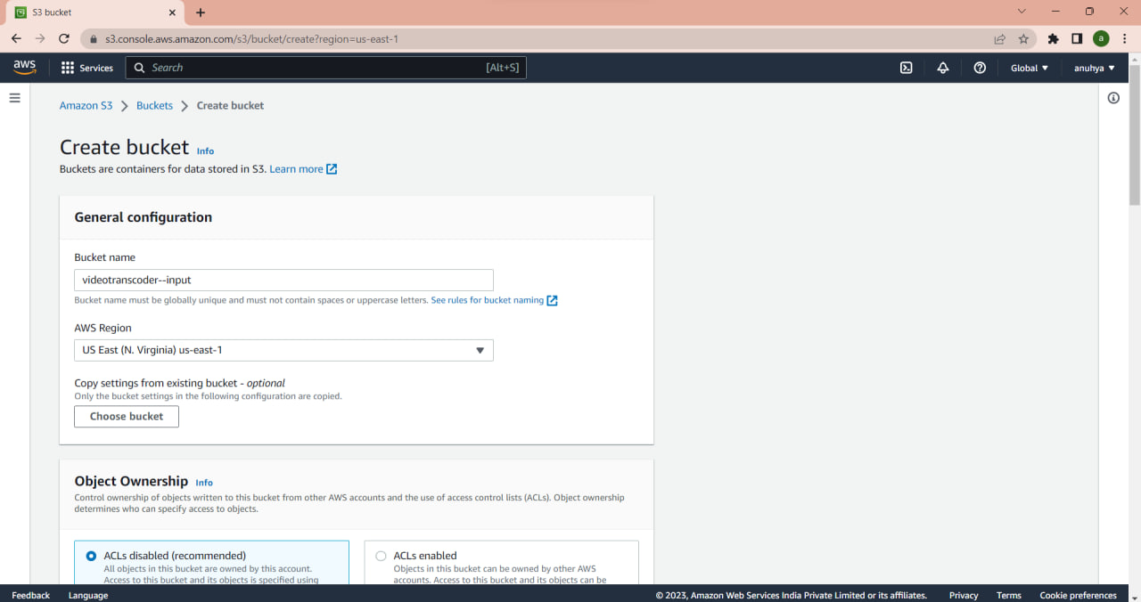

SESSION DESCRIPTION (Cont..)
STEP 2: Create Amazon S3 Bucket

Slide 7
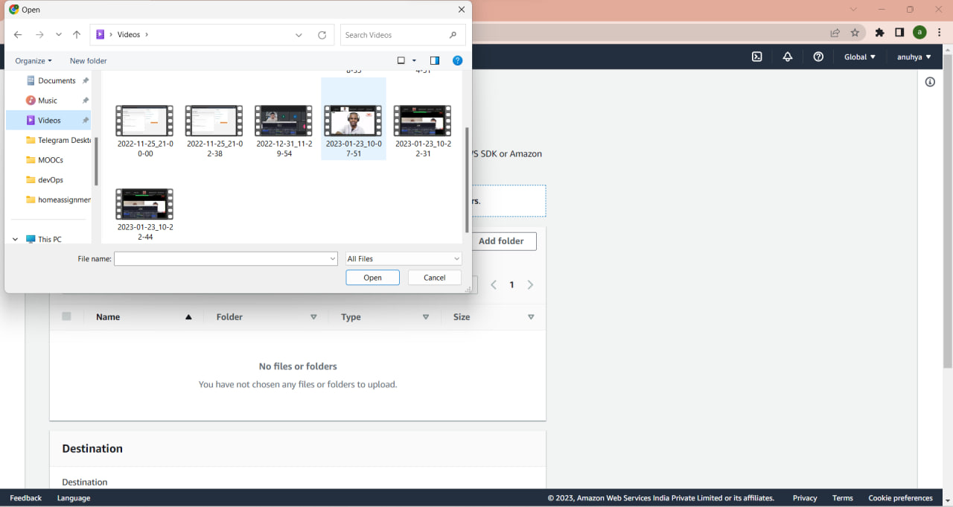
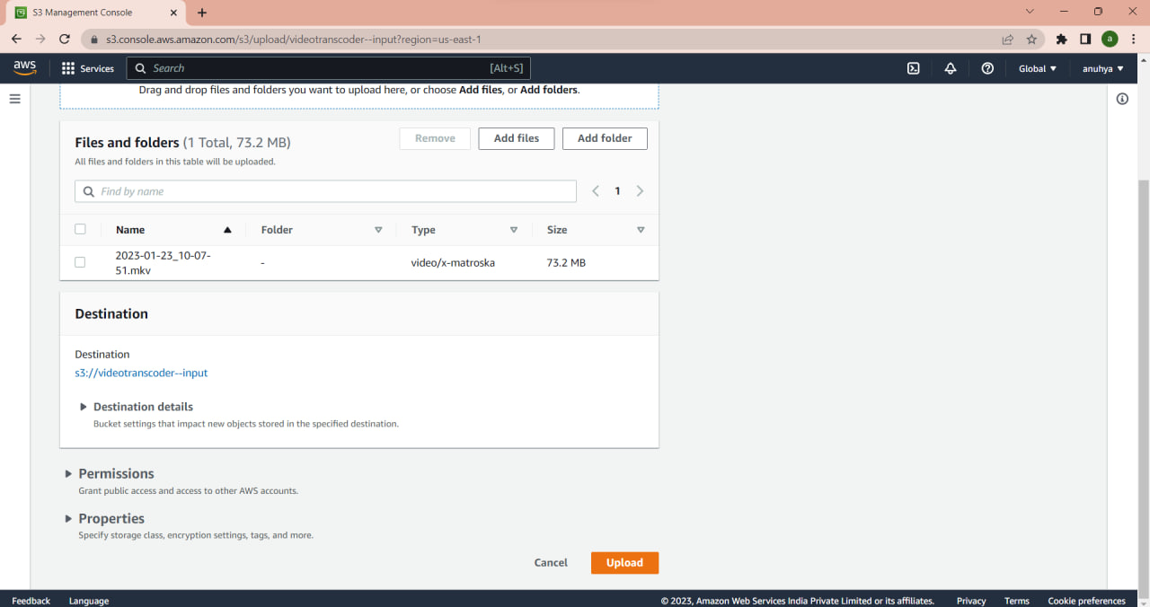
Upload the file to be transcoded to the input bucket

Slide 8
Create New Pipeline

Slide 9
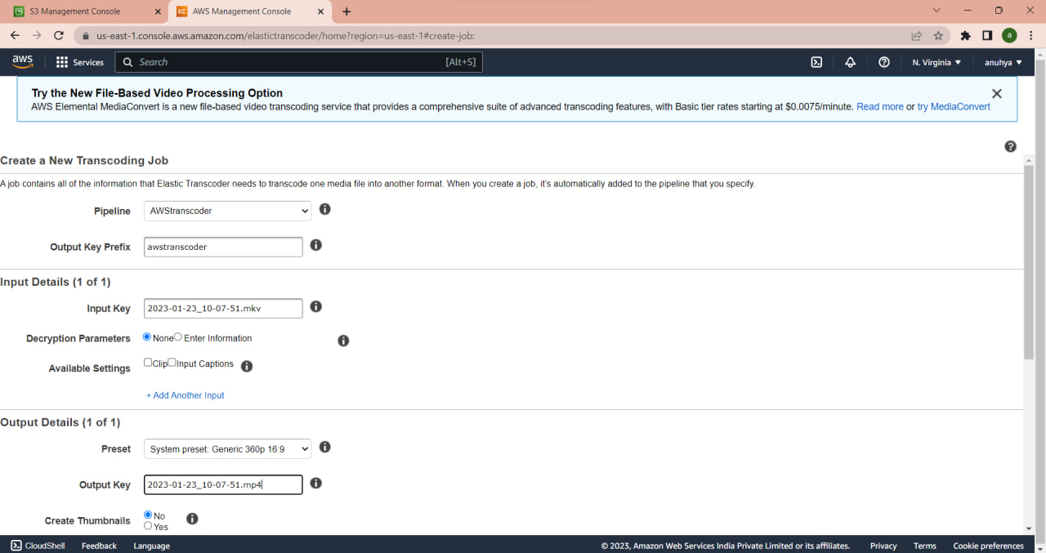
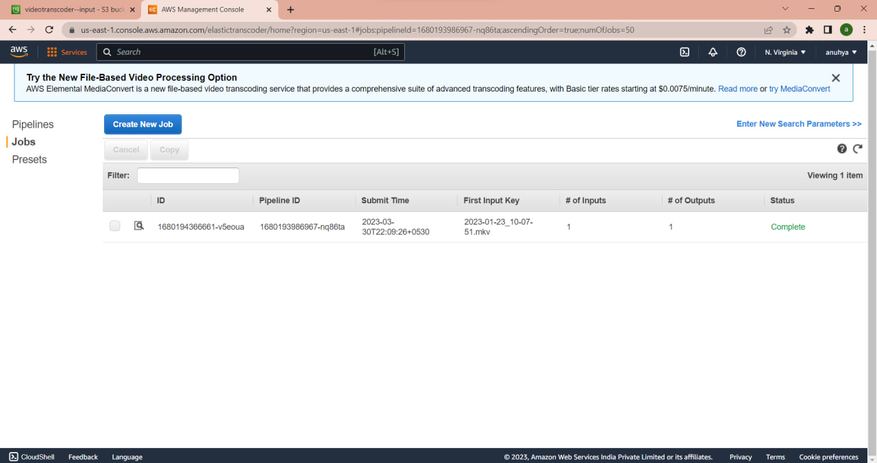
Create New Job and open jobs select the pipeline and search

Slide 10
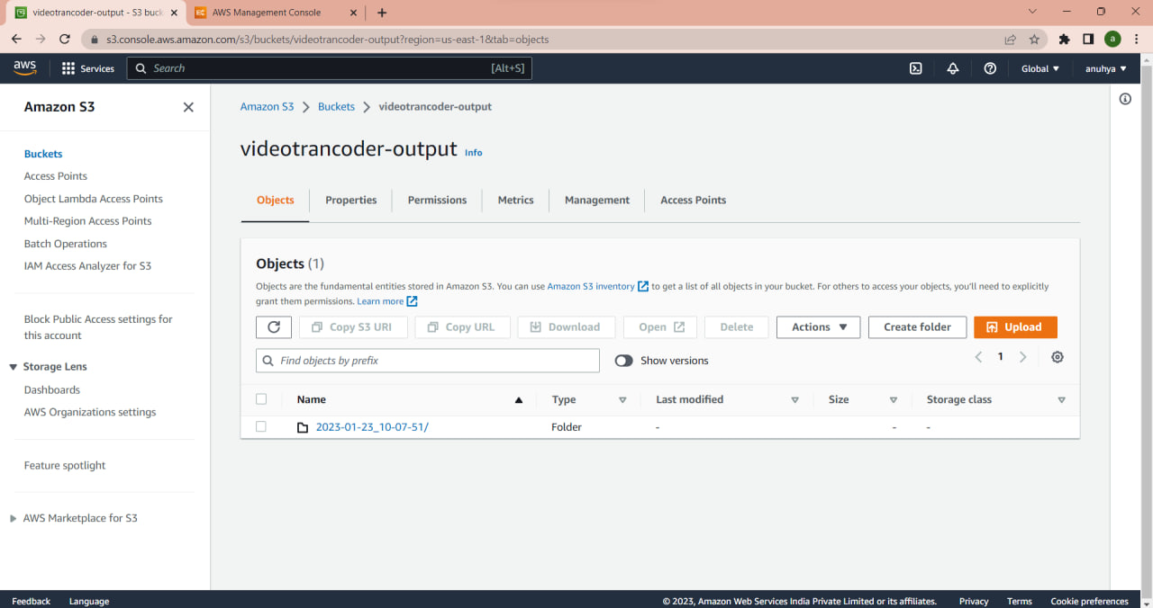
Final output

Slide 11
REFERENCES FOR FURTHER LEARNING OF THE SESSION
Sites and Web links:
1. https://aws.amazon.com/elastictranscoder/

Slide 12
THANK YOU

